Slide 1
Amazon Fine Food Review : Sentiment analysis and Review Summarization
Class: DS6101 Under Guidance of Prof. Ram Hariharan
Members:
Kailash Nadkar 001387392
Shilpa 001406044
ALIVIA Guin 001061445

Slide 2
Abstract:
This work demonstrates the use of machine learning and Deep learning techniques to perform sentiment analysis and reviews summarization on the Amazon food reviews dataset consisting of over 550,000 reviews recorded.
Problem statement 1 :
Given a labeled dataset consisting of user reviews and associated sentiments, develop models to predict sentiments on test reviews and evaluate the efficacy of the models.
Problem statement 2 :
Customer reviews can often be long and descriptive. Analyzing these reviews manually, as you can imagine, is really time-consuming. This is where the brilliance of Natural Language Processing can be applied to generate a summary for long reviews.

Slide 3
Dataset:
Dataset is taken from Kaggle: https://www.kaggle.com/snap/amazon-fine-food-reviews
This dataset consists of reviews of fine foods from amazon. The data span a period of more than 10 years, including all ~500,000 reviews up to October 2012. Reviews include product and user information, ratings, and a plain text review. It also includes reviews from all other Amazon categories.
Data includes:
Reviews from Oct 1999 - Oct 2012
568,454 reviews
256,059 users
74,258 products
260 users with > 50 reviews

Slide 4
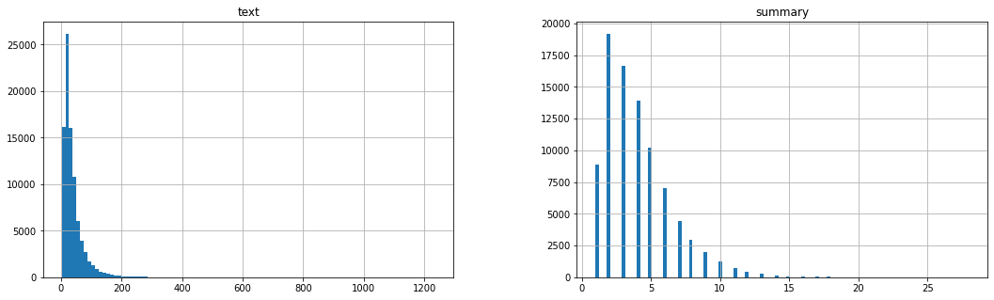
Data Cleaning and Preprocessing:
We cleaned and process data using:
Beautiful Soup
Regular expression
wordnet to remove stop words
custom data contractions method
Text and Summary Data Distribution

Slide 5
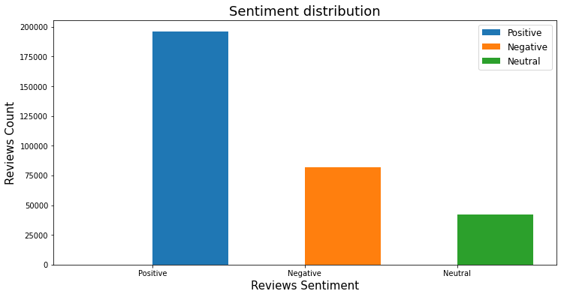
Data Visualization: Sentiment Distribution

Slide 6
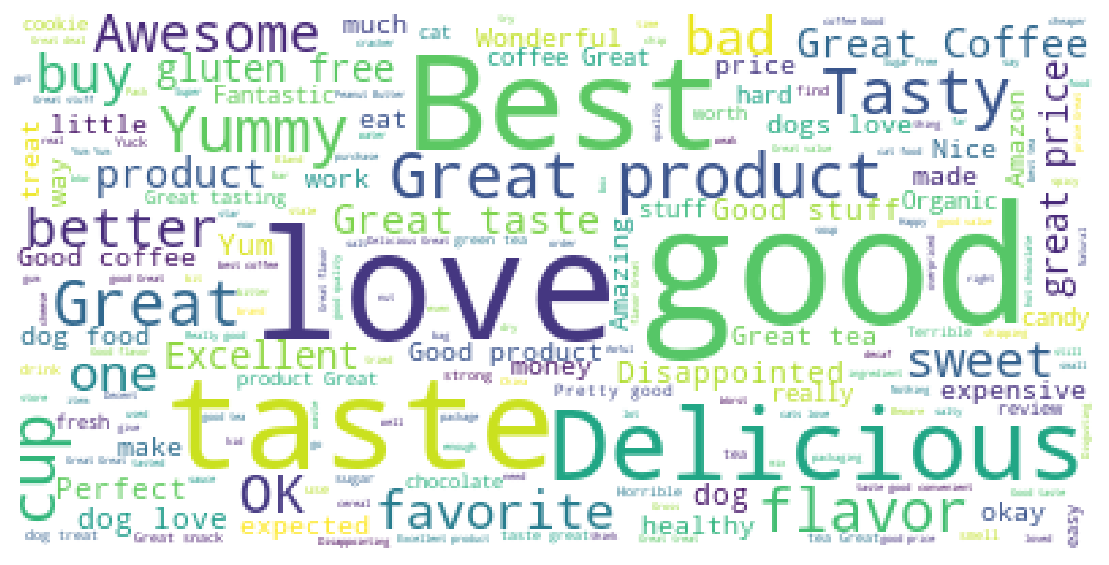
Data Visualization: Review Word-Cloud

Slide 7
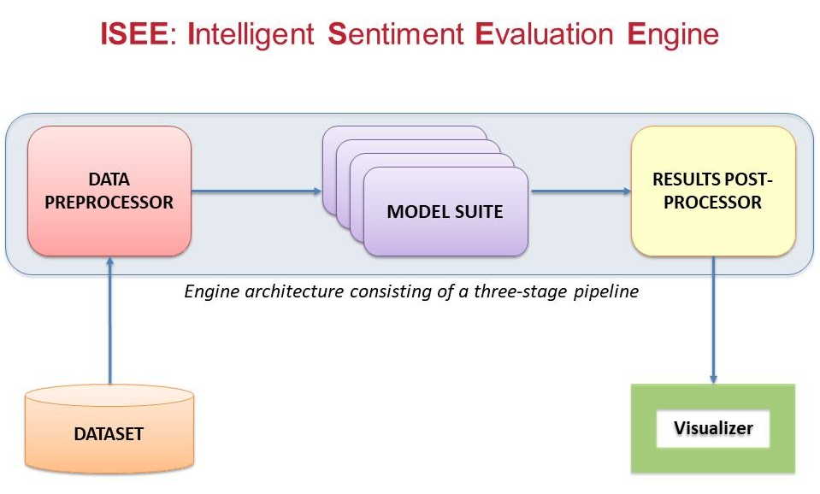
Sentiment Analysis: Architecture

Slide 8
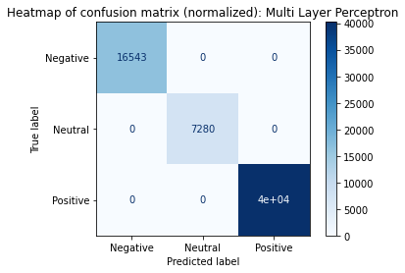
Sentiment Analysis: Modeling
We Build Model Pipeline to perform sentiment analysis using multiple models:
Multinomial Naive Bayes
Logistic Regression
Support Vector Machine
Decision Tree Classifier
Random Forest Classifier
Multi Layer Perceptron
Calculated execution time
Train and validated the model
Predicted Sentiment accuracy on validation set
Plot confusion matrix

Slide 9
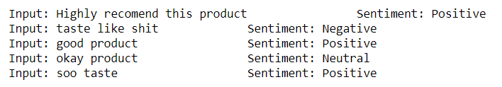
Sentiment Analysis: Results
Multi Layer Perceptron model performance on real world text example
Sentiment Analysis model performance
Model | Accuracy | Test Performance
1. Multinomial Naive Bayes | 78.13 % | Good, Fastest
2. Logistic Regression | 85.25 % | Okay performance on real world data
3. Support Vector Machine | 86.54 % | Good
4. Decision Tree Classifier | 83.83 % | Poor-Overfitting while training
5. Random Forest Classifier | 87.29 % | Poor-Overfitting,Too long to train
6. Multi Layer Perceptron | 86.29 % | Excellent

Slide 10
Sentiment Analysis: Conclusion
The Multi Layer Perceptron is the best model among all models
Naïve Bayes model converge faster, and model performance is good on real world data
Decision Tree Classifier and Random Forest took lots of time to converge. Performed good on validation set but poorly on real world data. Overfitting is the culprit here.
Logistic Regression performed better on both validation and real-world data
Support vector machine showed underwhelming performance

Slide 11
Text Summarization: Abstractive
Text summarization is the technique for generating a concise and precise summary of voluminous texts while focusing on the sections that convey useful information, and without losing the overall meaning. Automatic text summarization aims to transform lengthy documents into shortened versions, something which could be difficult and costly to undertake if done manually.
Abstractive Summarization:
New sentences is generated from the original text.
This is in contrast to the extractive approach where we used only the sentences that were present.
The sentences generated through abstractive summarization might not be present in the original text

Slide 12
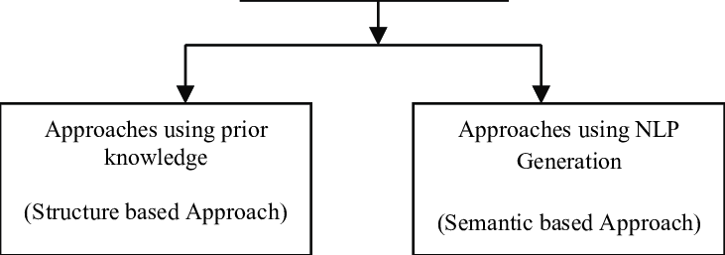
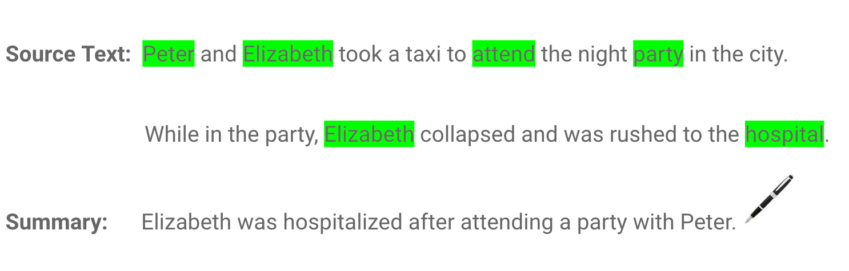
Text Summarization: Approach and Example
We will be summarizing Amazon Fine Food Reviews using LSTM encoder-Decoder model
To interpret and summarized reviews we implemented Seq2Seq model
To Generate Summary, we are using NLP Semantic based approach
Summarization Approach | Abstraction Summarization Example

Slide 13
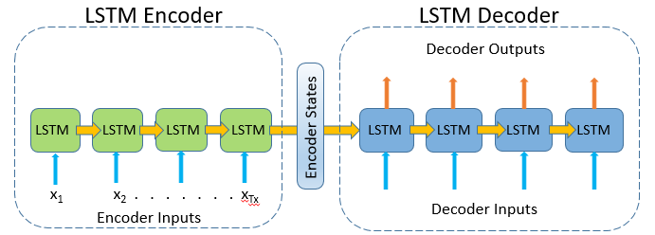
Text Summarization: Modeling
LSTM model: In the training phase, we will first set up the encoder and decoder.
Encoder: A stack of several recurrent units (LSTM or GRU cells for better performance) where each accepts a single element of the input sequence, collects information for that element and propagates it forward.
Decoder: The decoder is also an LSTM network which reads the entire target sequence word-by-word and predicts the same sequence offset by one timestep. The decoder is trained to predict the next word in the sequence given the previous word.

Slide 14
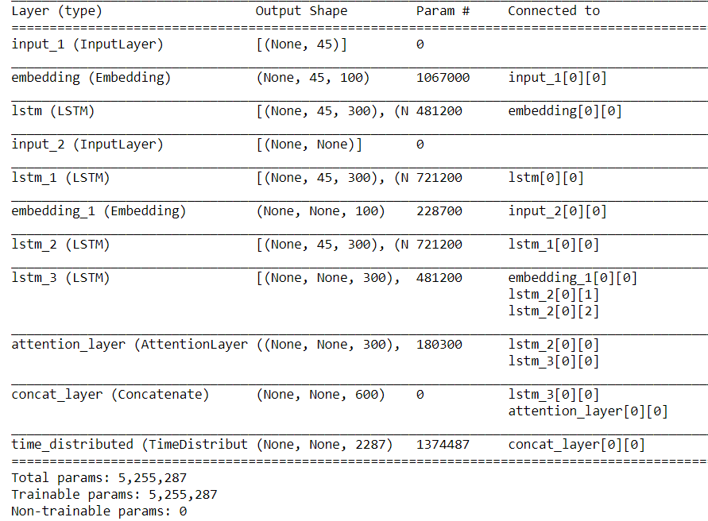
Text Summarization: Training LSTM Model
We are building a 3 stacked LSTM Model with following steps:
Early Stopping
Step Learn rate decay
Training on GPU
Saving the Model

Slide 15
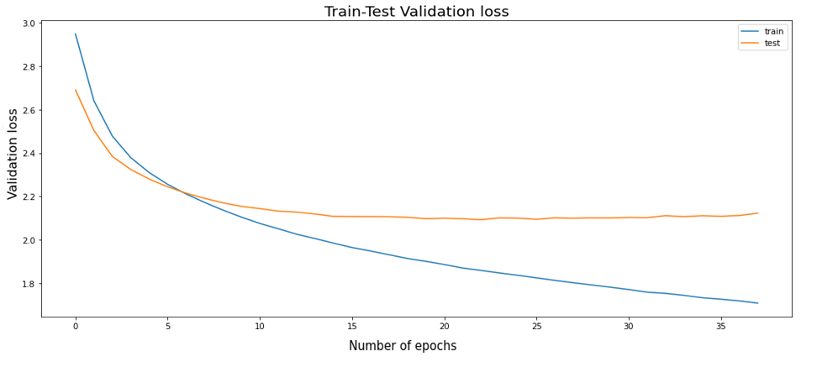
Text Summarization: Training Summary
LSTM model training and testing validation loss.

Slide 16
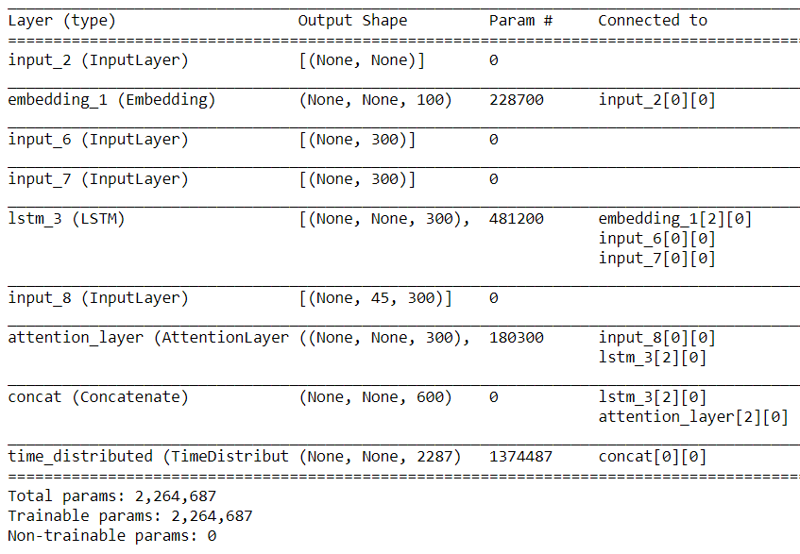
Text Summarization: Inference Phase
Creating Decoder model: Seq2Seq Model
After training, the model is tested on new source sequences for which the target sequence is unknown. So, we need to set up the inference architecture to decode a test sequence.

Slide 17
Text Summarization: Results
Some of the generated Summary with cleaned review, original summary, and our generated summary:

Slide 18
Text Summarization: Conclusion
We have successfully summarized the reviews of amazon fine food
We have implemented Abstractive text summarization
We cleaned and process data using Beautiful Soup, Regular expression, wordnet to remove stop word, and using custom data contractions method
Tokenized the data and split it into 80% - 20% test and train respectively
We used LSTM Encoder-decoder architecture for text data parsing and modeling
The reviews summary is generated using Seq2Seq architecture
We generated summary for 100 reviews with very good quality text

Slide 19
Thank You

